Slide 1
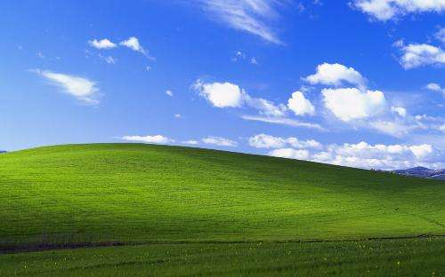
What is operating system?
User
Application
operating
system
Hardware

Slide 2
Operating system development
1945-1950
Manual operation method
Mid 1950s
Mid 1960s
Multiprogramming system

Slide 3
Three IMPORTANT parts of the operating system
Process Model
Memory Management
File System

Slide 4


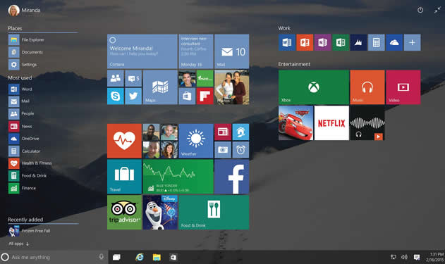
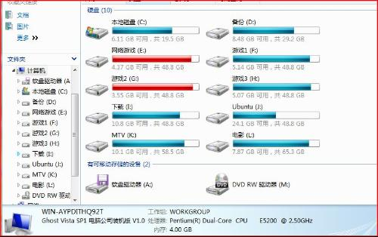
What can they actually do?
process/thread, file system, and memory management

Slide 5
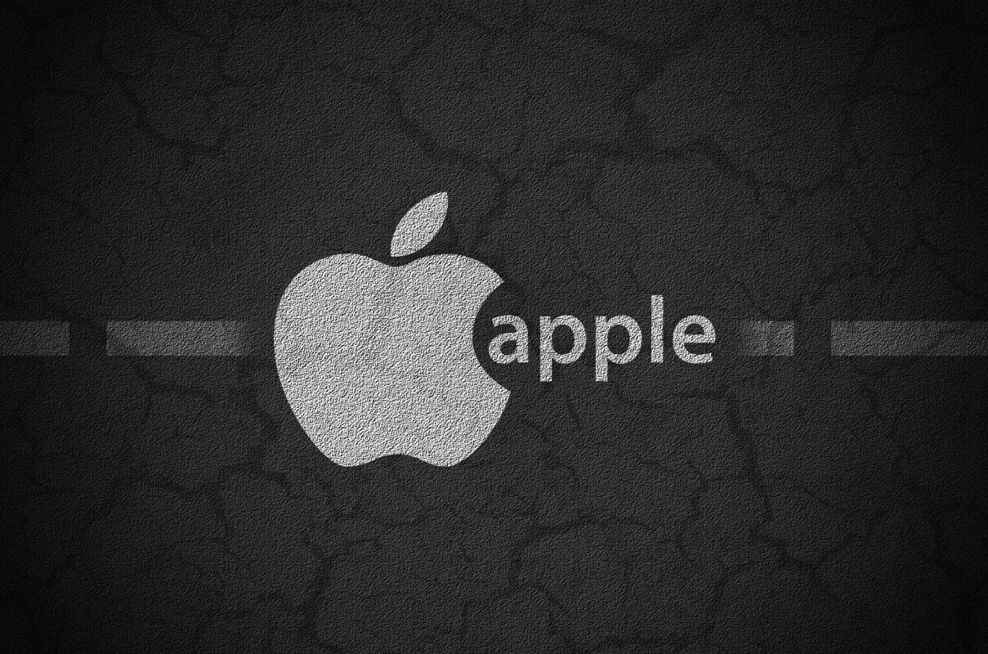
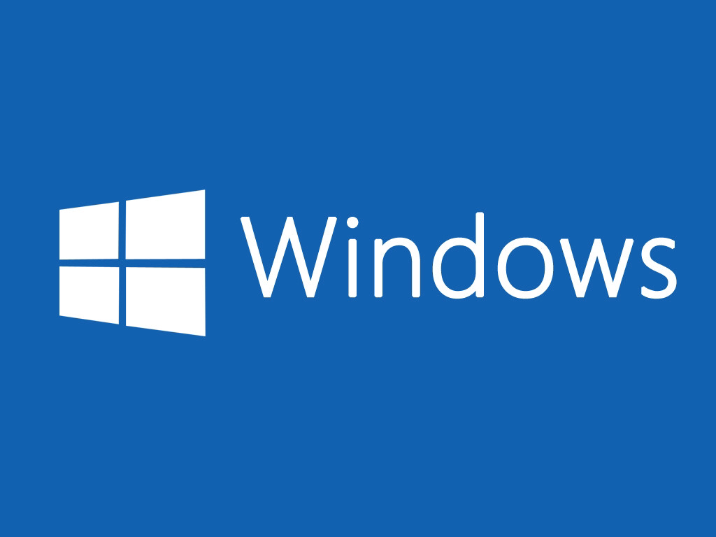
V.S
more artistic?
easier to use?

Slide 6
Operating system in future
1. Ubiquitous operating system
2. Network security

